Slide 1

Individual homework Predicate Resolution
Ceontea Vlad - Călin - 912

Slide 2
Exercise 4.2
Using a refinement of predicate resolution prove:
2. the semi-distributivity of ‘∃’ over ‘∧’:
⊢ (∃x)(P(x)∧Q(x)) → (∃x)P(x)∧(∃x)Q(x)
⊬ (∃x)P(x)∧(∃x)Q(x) → (∃x)(P(x)∧Q(x))

Slide 3
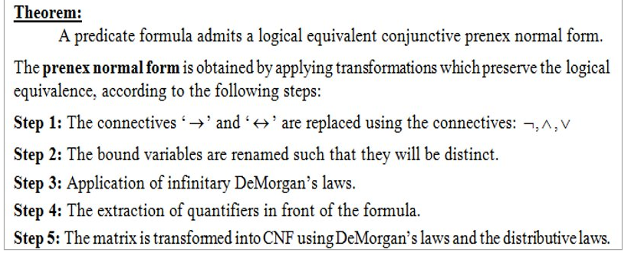
Theoretical Results

Slide 4
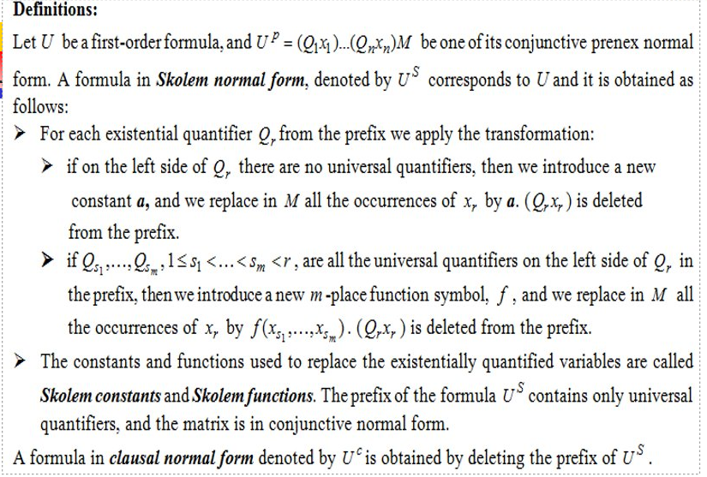

Slide 5
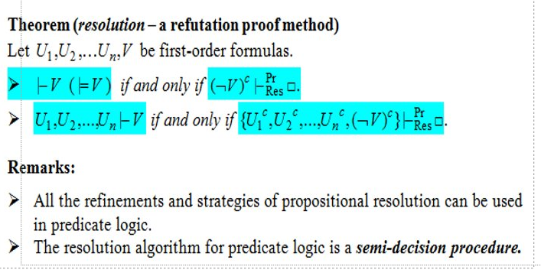

Slide 6
Solution
We consider the following formulas:
U₁ = (∃x)(P(x)∧Q(x)) → (∃x)P(x)∧(∃x)Q(x) and
U₂ = (∃x)P(x)∧(∃x)Q(x) → (∃x)(P(x)∧Q(x))
⊢ U₁ if and only if (¬U₁)^{C} ⊢^{Pr}_{Res} ◻
⊬ U₂ if and only if (¬U₂)^{C} ⊬^{Pr}_{Res} ◻

Slide 7
¬U₁ = ¬((∃x)(P(x) ∧ Q(x)) → (∃x)P(x) ∧ (∃x)Q(x))
We replace 'A → B' with '¬A ∨ B'
≡ ¬(¬(∃x)(P(x) ∧ Q(x)) ∨ (∃x)P(x) ∧ (∃x)Q(x))
≡ (∃x)(P(x) ∧ Q(x)) ∧ ¬((∃x)P(x) ∧ (∃x)Q(x))
≡ (∃x)(P(x) ∧ Q(x)) ∧ (¬(∃x)P(x) ∨ ¬(∃x)Q(x))
We apply infinitary DeMorgan's law
≡ (∃x)(P(x) ∧ Q(x)) ∧ ((∀x) ¬P(x) ∨ (∀x) ¬Q(x))
We replace the bound variables
≡ (∃x)(P(x) ∧ Q(x)) ∧ ((∀y) ¬P(y) ∨ (∀z) ¬Q(z))
We extract the quantifiers, '∃' being the first
≡ (∃x)(∀y)(∀z)(P(x) ∧ Q(x) ∧ (¬P(y) ∨ ¬Q(z))
(¬U₁ )^{p} = (∃x)(∀y)(∀z)(P(x) ∧ Q(x) ∧ (¬P(y) ∨ ¬Q(z)) - The prenex form
[x ← a], a - Skolem constant

Slide 8
(¬U₁ )^{s} = (∀y)(∀z)(P(a) ∧ Q(a) ∧ (¬P(y) ∨ ¬Q(z)) - The Skolem form
(¬U₁ )^{c} = P(a) ∧ Q(a) ∧ (¬P(y) ∨ ¬Q(z)) - The clausal normal form
We have the set of clauses:
S₁ = {C₁ = P(a), C₂ = Q(a), C₃ = ¬P(y) ∨ ¬Q(z)}
The resolvents:
C₄ = Res ^{Pr}_{[y← a]} (C₁, C₃) = ¬Q(z)
C₅ = Res ^{Pr}_{[z← a]} (C₂, C₄) = ◻
We proved that (¬U₁)^{C} ⊢^{Pr}_{Res} ◻ and thus ⊢ U₁

Slide 9
¬U₂ = ¬((∃x)P(x) ∧ (∃x)Q(x) → (∃x)(P(x) ∧ Q(x)))
We replace 'A → B' with '¬A ∨ B'
≡ ¬(¬((∃x)P(x) ∧ (∃x)Q(x)) ∨ (∃x)(P(x) ∧ Q(x)))
≡ (∃x)P(x) ∧ (∃x)Q(x) ∧ ¬(∃x)(P(x) ∧ Q(x))
We apply infinitary DeMorgan's law
≡ (∃x)P(x) ∧ (∃x)Q(x) ∧ (∀x)¬(P(x) ∧ Q(x))
≡ (∃x)P(x) ∧ (∃x)Q(x) ∧ (∀x)(¬P(x) ∨ ¬Q(x))
We replace the bound variables
≡ (∃x)P(x) ∧ (∃y)Q(y) ∧ ((∀z) ¬P(z) ∨ ¬Q(z))
We extract the quantifiers, '∃' being the first
≡ (∃x)(∃y)(∀z)(P(x) ∧ Q(y) ∧ (¬P(z) ∨ ¬Q(z))
(¬U₂ )^{p} = (∃x)(∃y)(∀z)(P(x) ∧ Q(y) ∧ (¬P(z) ∨ ¬Q(z)) - The prenex form
[x ← a], [y ← b], a, b - Skolem constants

Slide 10
(¬U₂ )^{s} = (∀z)(P(a) ∧ Q(b) ∧ (¬P(z) ∨ ¬Q(z)) - The Skolem form
(¬U₂ )^{c} = P(a) ∧ Q(b) ∧ (¬P(z) ∨ ¬Q(z)) - The clausal normal form
We have the set of clauses:
S₂ = {C₁' = P(a), C₂' = Q(b), C₃' = ¬P(z) ∨ ¬Q(z)}
The resolvents:
C₄' = Res ^{Pr}_{[z← a]} (C₁', C₃') = ¬Q(a)
C₅' = Res ^{Pr}_{[z← b]} (C_{2'}, C₃') = ¬P(b)
¬Q(a) and Q(b) are not unifiable because a and b are constants, so the clauses C₂' and C₄' do not resolve.
P(a) and ¬P(b) are not unifiable because a and b are constants, so the clauses C₁' and C₅' do not resolve.
We proved that (¬U₂)^{C} ⊬^{Pr}_{Res} ◻ and thus ⊬ U₂

Slide 11
Conclusion
So, because ⊢ U₁ and ⊬ U₂ , we can conclude that '∃' is not distributive over '∧', but only semi-distributive.

